Slide 1


Web scraping to gain company insights
PRESENTED BY
S M GAZZALI ARAFAT NISHAN
Date: 24-07-2023

Slide 2
Purpose
This project aims to analyze web-collected customer feedback data, particularly focusing on British Airways (BA) reviews. As a BA data scientist, the task involves extracting valuable insights from this data to impact decisions, reduce costs, and boost revenue. The end goal is to concisely and visually present these findings at the upcoming board meeting.

Slide 3
Analysis Approach
1. Data Scraping
2. Data Cleaning and Preparation
3. Data Analysis

Slide 4
Insights
The insights obtained from the data analysis is summarized and presented in the end of the PowerPoint slide. The focus is on creating informative visualizations and metrics to effectively convey the key points from the analysis. The PowerPoint slide has also included clear and concise explanations to provide a quick understanding of the findings.

Slide 5
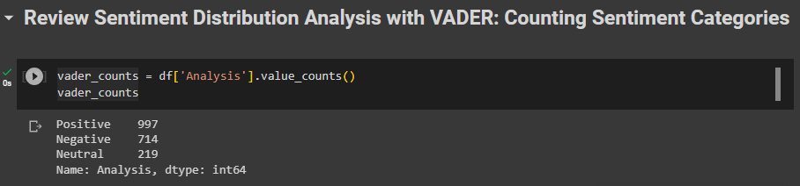
Review Sentiment Distribution Analysis with VADER: Counting Sentiment Categories
Total number of reviews: 2000

Slide 6
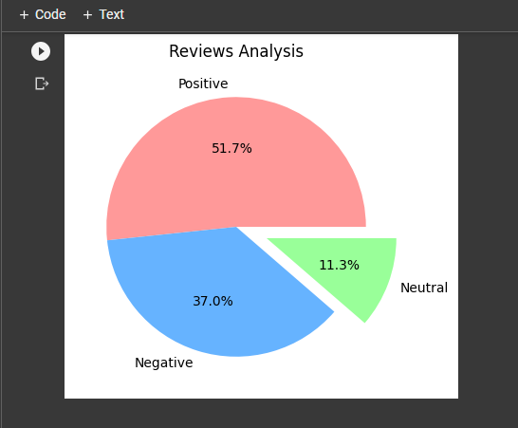
Visualizing Review Analysis with Pie Chart: Categorizing Sentiment Distribution in a Colorful Pie Chart

Slide 7
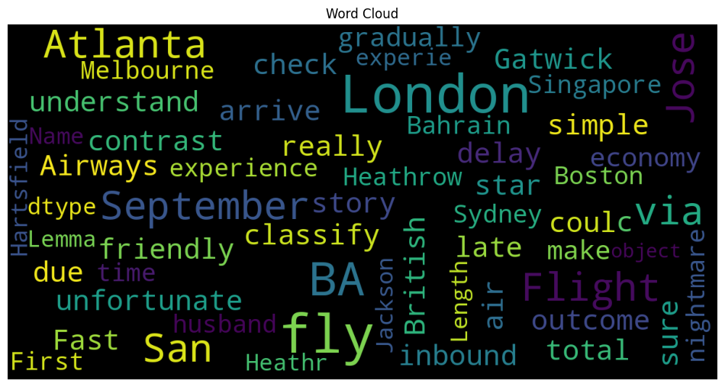
Visualizing Textual Data with Word Cloud: Analyzing Word Frequency through Word Cloud Visualization

Slide 8
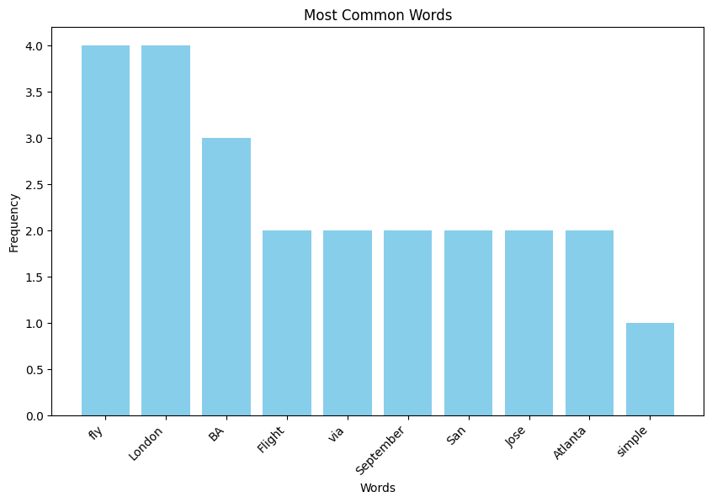
Visualizing Most Common Words with Bar Chart: Analyzing Word Frequency in Textual Data

Slide 9
THANK YOU
S M Gazzali Arafat Nishan
gazzali.nishan@northsouth.edu
www.beacons.ai/hashcatnissan

